Slide 1
Proposal for Dissertation Proposal

Slide 2
Objectives
How do Pacific oysters respond to environmental stresses?
Ceramide
Ocean acidification stress on larvae
Ocean acidification and a secondary stress on juveniles
Effects of ocean acidification on fitness

Slide 3
Ceramide synthesis and metabolism
Ceramide is an important signaling molecule in the vertebrate stress response
What is ceramide’s role, if any, in C. gigas? Is it an important component of the stress response?

Slide 4
Ceramide synthesis and metabolism
In sililco gene discovery
Gene sequencing and homology with vertebrate sequences
Gene expression under environmental stress
Levels of apoptosis under environmental stress

Slide 5
Ceramide: Methods
SRA and EST sequences were assembled and blasted against SwissProt
Top blast hits were screened for ceramide-associated genes
4 genes were chose: serine palmitoyltransferase, 3-ketodihydrosphingosine reductase, acid ceramidase, and ceramide glucosyltransferase

Slide 6
de novo synthesis
Catabolic generation
Sphingoymyelinase
Sphingomyelin
Serine + Palmitoyl CoA
Serine palmitoyltransferase^{Cg}
Cerebrosidase
Glucosylceramide
3-Ketosphinganine
Ceramide synthase
Sphingosine
3-ketodihydrosphingosine reductase
Dihydrosphingosine
Phosphatase
Ceramide 1-P
Ceramide synthase^{Cg}
Dihydroceramide
Desaturase
CERAMIDE
SM synthase^{Cg}
Sphingomyelin
Glucosylceramide synthase^{Cg}
Glucosylceramide
Ceramidase^{Cg}
Sphingosine
Ceramide kinase^{Cg}
Ceramide 1-P
metabolism

Slide 7
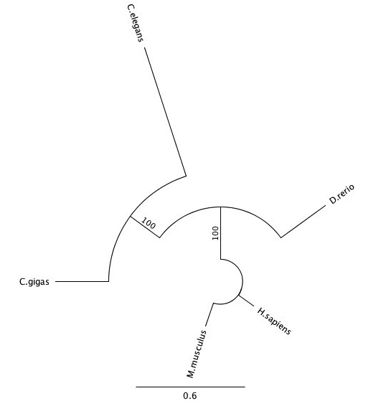
Ceramide: Methods
Primers designed for both sequencing and qPCR
Full length sequences aligned with homologous sequences in other organisms

Slide 8
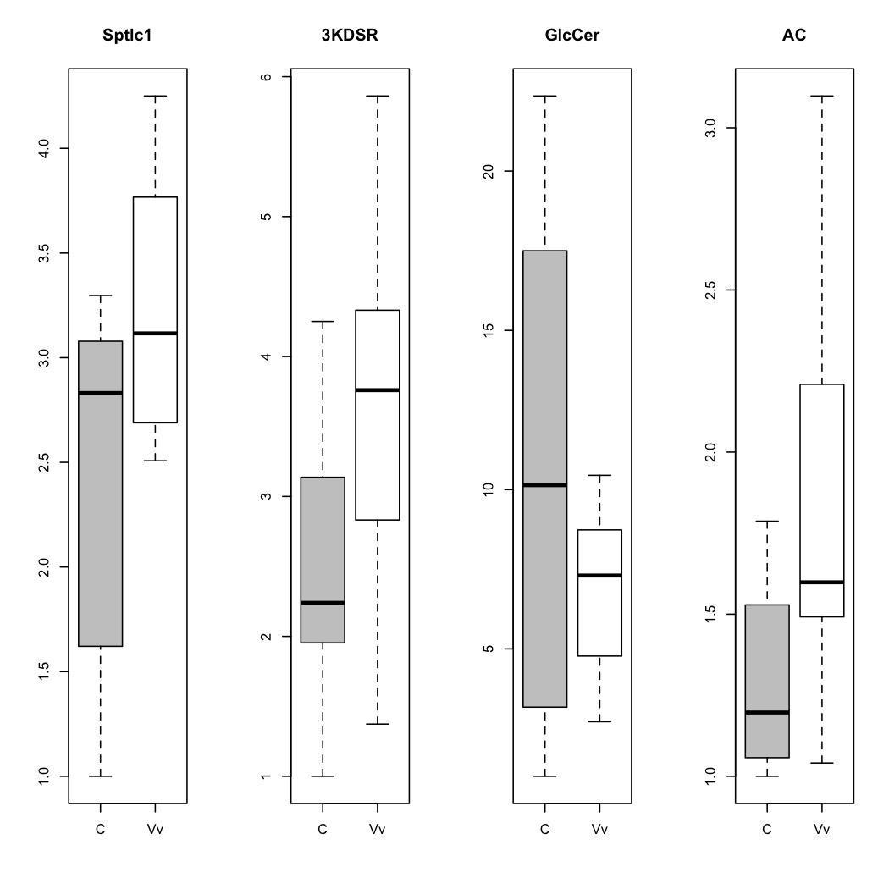
Ceramide: Methods
Juvenile C. gigas were exposed to V. vulnificus for 3 hours and RNA was extracted from gill tissue

Slide 9
Ceramide: Methods
Immune challenge of juvenile C. gigas
  V. tubiashii at 10⁴ and 10⁶ CFU/mL for 3 and 5 days
qPCR 4 ceramide pathway genes – gill and hemocytes
Measure levels of apoptosis in hemocytes (Haimovitz-Friedman et al. 1994)
  Measure fragmentation of DNA
  Changes in nuclear chromatin

Slide 10
Ocean Acidification and Larvae
How does exposure to acidic conditions affect early larval development and growth?
Larval exposure to 4 different pCO₂
Effects of different pCO₂ on: development, growth, calcification, and physiology

Slide 11
Larvae: Methods
pCO₂ levels: 400, 700, 1000, and 1500 µatm
21°C
Water flowing into the larval containers was monitored for pH, DIC and TA
Water within the larval containers was monitored for pH and TA

Slide 12
Larvae: Methods
Eggs were fertilized in pCO₂ treatment water (6 replicates per treatment)
Samples were taken and fixed at 1 and 6 hours post-fertilization and at 1 and 3 days post-fertilization
Samples were taken for RNA extraction at 4 days post-fertilization

Slide 19
Trocophore
Pre-hatching
Pre-gastrula

Slide 20
Notes:
Significance: 400 compared to all; 700 vs 1000; 1000 vs. 1500

Slide 24
Larvae: Methods
Next steps
  Extract RNA and determine concentrations
    1-12 ng/µL
  qPCR of candidate genes:
    Shell mineralization (8 proteins isolated by Marie et al. 2011; Kurihara et al. 2007)
    Oxidative stress: peroxiredoxin, superoxide dismutase (Tomanek et al. 2011)
    Energy metabolism: ATP synthase, citrate synthase, pyruvate kinase, thiolase (Stumpp et al. 2011; Wong et al. 2011)
    Molecular chaperones (Wong et al. 2011)
  Analyze SEM photos

Slide 25
Ocean Acidification and Secondary Stress
How does exposure to ocean acidification impact the oyster’s physiological response to a second environmental stress?
Precondition oysters to one of 3 pCO₂ for 1 or 2 weeks
Expose to second stressor PCP for 1 week at 2 different environmentally relevant levels
Assess gene expression and gill histology

Slide 26
Secondary Stress: Methods
pCO₂: 400, 700, 1500 µatm
pCO₂ 1 week
pCO₂ 2 weeks
PCP 1 week
0.05 µg/L
PCP 1 week
0.15 µg/L
Control
PCP 1 week
0.05 µg/L
PCP 1 week
0.15 µg/L
Control
•Gene expression in gill tissue – NGS or candidate genes qPCR
•Histology of gill tissue

Slide 27
Secondary Stress: Genes
Genes involved in electron transport chain (Shofer & Tjeerdema 1993)
  Cytochrome oxidase
  NADH dehydrogenase
  ATP synthase
Genes in detoxification response
  Glutathione-s-transferase
  Peroxiredoxin 6
  Superoxide dismutase
  Catalase
  Phenoloxidase
Ceramide pathway

Slide 28
Ocean Acidification and Fitness
Do certain genotypes confer a selective advantage to thriving under ocean acidification conditions?
Condition hatchery oysters and oysters from a wild population for 2 months under 3 different pCO₂
Quantify gonadal development
Promote spawning using a temperature change
Assess larval development and survival after 24 hours

Slide 29
Fitness: Methods
50 Wild Oysters
50 Selectively Bred Oysters
400, 700, or 1000 µatm
2 months
Quantify gonadal development
20 oysters from each
Spawn 30 oysters
Spawn 30 oysters
Larvae
•genotype survivors after 24 h
•quantify growth and calcification at 24 h
Notes:
Genotype adults

Slide 30
Fitness: Methods
Gonadal development (Li et al. 2000)
  Histology: quantify gametogenesis; biochemical analysis?
Genotyping – broodstock and larvae
  RAD sequencing of genome (adults and larvae) to find changes in diversity between treatments and in family composition
  RAD sequencing of transcriptome (larvae) to find changes in genes associated with survival

Slide 31
TIMELINE
Finish ceramide paper – September 2011
qPCR of larvae OA – September 2011
  Write paper? October-November 2011
Write dissertation proposal and general exam – August – September 2011
Secondary stress pCO₂ and PCP exposures – October 2011
Secondary stress RNA extraction, qPCR/sequencing and histology – November-December 2011
Secondary stress analysis and write paper – January 2012
Precondition adults for fitness experiment – February-March 2012
Fitness experiment assess 24h of larval development; fix samples for gonad histology – March/April 2012
Genotype and histology of fitness experiment – April – June 2012
Write up fitness experiment – August 2012
V. tubiashii exposure, practice plating and qPCRing hemocytes for ceramide part II – September 2012
qPCR and apoptosis quantification; analysis of ceramide part II results – October-December 2012
Tie up loose ends and write dissertation - 2013

